Slide 1
Utilizing Social media for your local
Sarah McCann
NATCA Senior Communications & Public Affairs Associate

Slide 2
Why Social Media?
Notes:
-Important to set a mission and goals when establishing an account.

Slide 3
WHY SOCIAL MEDIA?
Notes:
-Why is it so important to have a mission? Look at the amount of data generated in one minute.

Slide 4
Why SOCIAL MEDIA?

Slide 5
How to start: Pick a platform
Notes:
-Mission and goals.
-Pick a platform. Start with one.
-Explain what we use at NATCA (FB, Twitter, Insta, LinkedIn) and why.
-Decide who is going to run account. Keep log of password(s).

Slide 6
HOW TO START: Facebook
Page vs. Profile vs. Group
Page is best for function, interaction and followers
Scheduling posts
Insights, analytics
Editing capabilities for posts
Accountability for posts
Can link to other outlets on page
Notes:
-Personal profiles are for non-commercial use and represent individual people. You can follow profiles to see public updates from people you're interested in but aren't friends with.
-Pages look similar to personal profiles, but they offer unique tools for businesses, brands and organizations. Pages are managed by people who have personal profiles. You can like a Page to see updates in News Feed. You can manage pages from your personal account.

Slide 7
HOW TO STAR: Twitter
Posts of 140-characters
Can include photos or 30 second video
Hashtags
Easily switch from personal to business account
Cannot edit
Notes:
-Photos no longer detract from your post’s character count.
-Every tweet since Twitter’s inception is archived at Library of Congress. LoC collecting web material since it began archiving congressional and presidential campaign websites in 2000. Deemed Twitter Research Project in 2010.

Slide 8
HOW TO START: Instagram
Post photos, videos and text
Up to one minute long videos now
Can now zoom
Photo filters
Links will not be clickable in text
Can push through to Facebook, Twitter and other outlets
Can easily toggle between personal and professional accounts
Can edit posts

Slide 9
FACEBOOK: A Page View
Notes:
Over all view – top bar, side bar, right bar with review

Slide 10
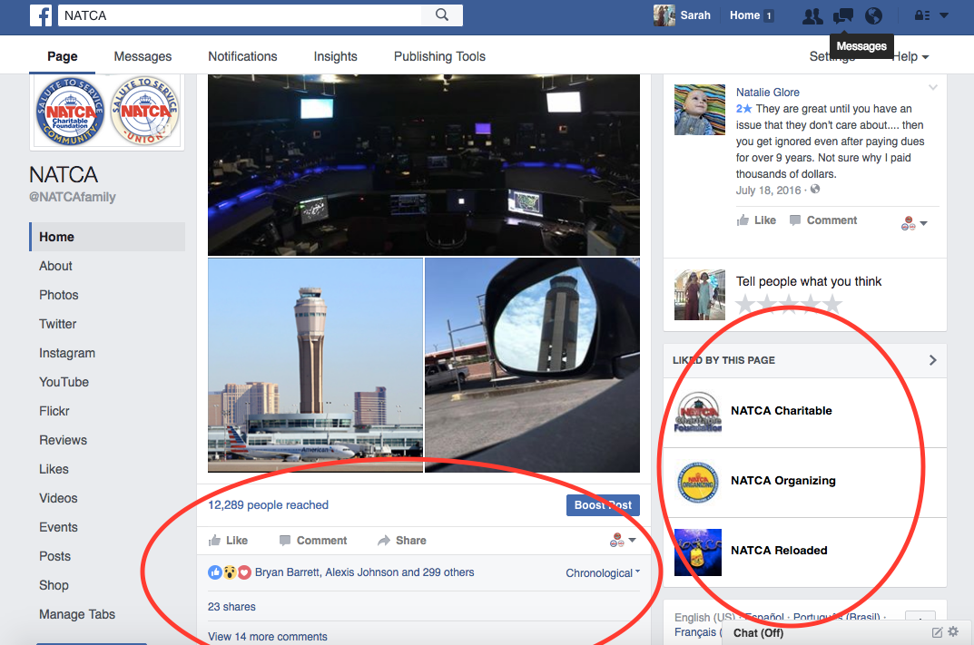
FACEBOOK: A Page View
Notes:
-Page manager view on posts. You don’t get this information if you establish your account as a profile.

Slide 11
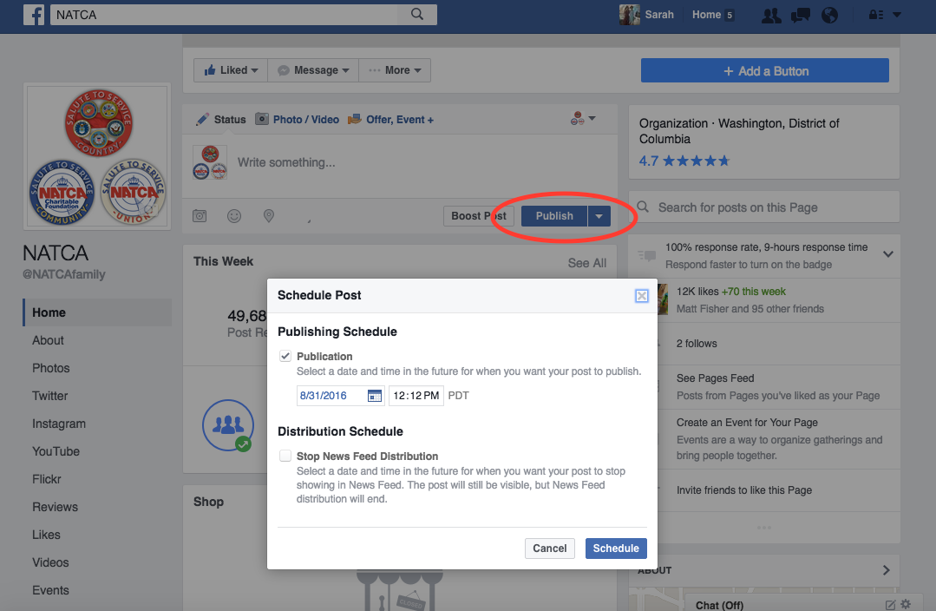
FACEBOOK: A Page View
Notes:
Scheduling capability. Publish, down turned triangle, select date and time.

Slide 12
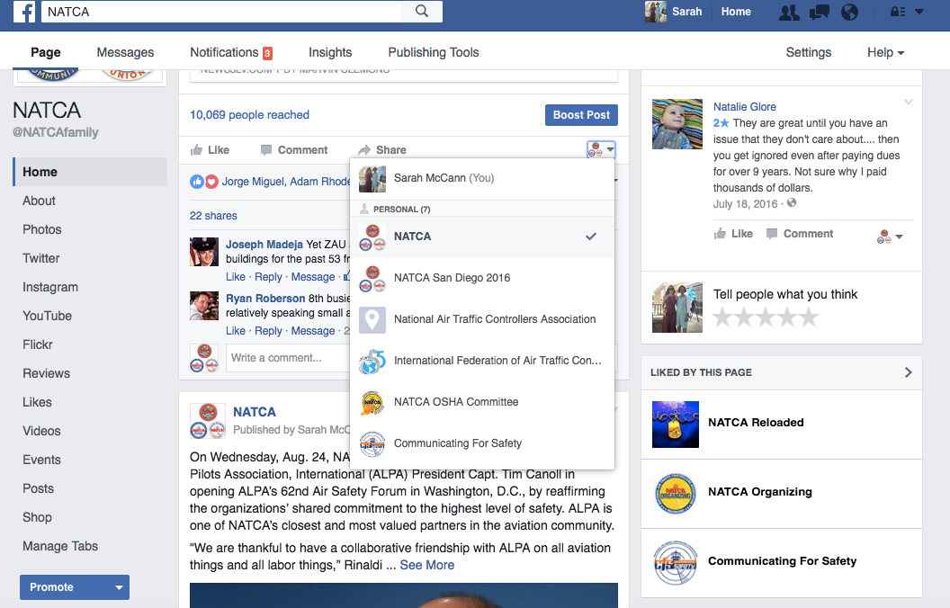
FACEBOOK: A Page View
Notes:
-Toggle among accounts
-Liked by this page

Slide 13
Facebook: INSIGHTS TO YOUR PAGE
Notes:
-Another advantage of having a page is your ability to check out the statistics of your page.
-If you have some extra free time and really want to get technical about your posts, you can analyze when people are liking posts, the demographics of the people following your page, which posts get the most engagements, which means likes, shares and views.

Slide 14
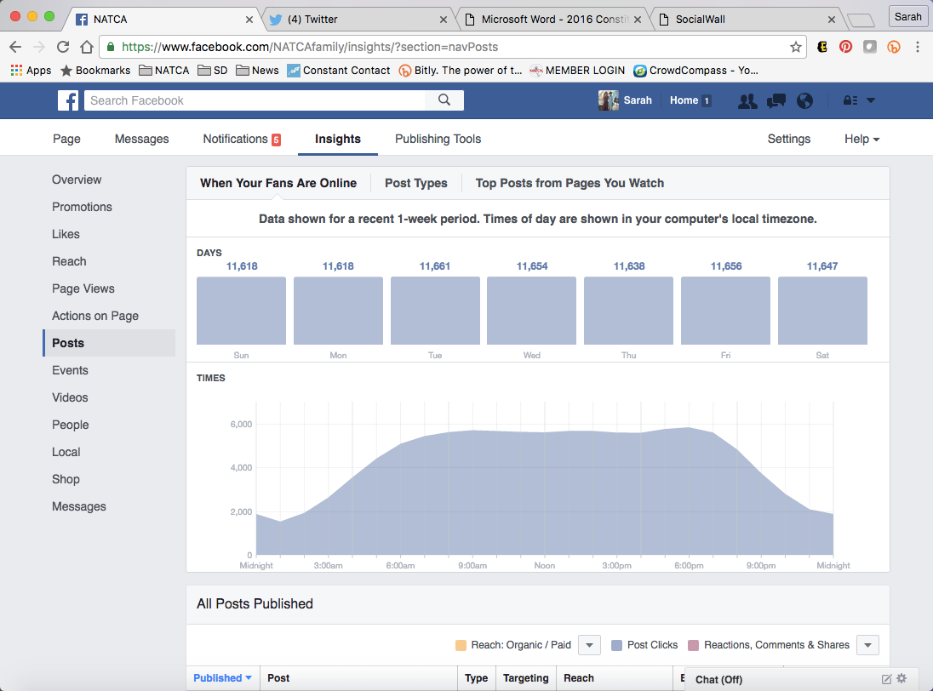
FACEBOOK: A Page View
Notes:
-An example of the kind of insights you can get.

Slide 15
BEST PRACTICES: Linking Accounts
Link accounts when you can
Efficiency
Still check all accounts and interact with followers
Notes:
Can link Instagram to other accounts
Can link FB to Twitter account so FB posts go through to Twitter
Include the most important information it the first sentence so it doesn’t get cut off by Twitter

Slide 16
BEST PRACTICES: LINKING ACCOUNTS
Twitter to Facebook: Settings, Apps, Connect to Facebook
Facebook to Twitter → https://www.facebook.com/twitter/
Instagram to Facebook and Twitter
Wheel, linked accounts, select mode, enter information

Slide 17
BEST Practices: content
Frequency of posting
Post on a regular basis
Creating vs. sharing content
Hashtags
Tagging
Photos
Liking/Following Other Accounts from Yours
Responding to comments
Notes:
-Regular posting is key to building followers; regular posts = engagements = showing up in more newsfeeds = more followers
-Sharing posts is good, but it’s also good to create some original content. Original content, meaning it’s something posted directly by the page, gets more engagements than a shared post.
-When you share, it’s always good to add in some words of your own too and a hashtag.
-Content doesn’t always have to be new

Slide 18
Best Practices: Frequency
Notes:
-General guidelines – you really have to get a feel for your audience and followers and tailor to their schedules.
-Posting one to two times a day or one to four times a week is best to keep followers interested while making sure they don’t feel like your page is cluttering their newsfeeds. If they feel you are spamming them, they will likely unfollow your page, or unlike it, which means they won’t see any of your content.
-Due to the nature of Facebook timelines, one post will remain visible for much longer than on Twitter. It is only necessary to post to Facebook 1-3 times per day in order to create the effect of a busy page.

Slide 19
BEST Practices: HASHTAGS
Hashtags
Do use common/trending
Don’t overuse
Do use NATCA hashtags
#NATCA
#NATCAFamily
#TheNATCADifference
#NATCAStrong
Notes:
-Hashtags increase the exposure of your post, and therefore your page/brand. This is a great tool if you want that information to reach many NATCA members, or other people interested in what you may be posting about.
-It doesn’t have to be NATCA specific hashtag either; use common/trending hashtags to become part of the discussion about that topic on the larger social media community. Example: posting on a holiday, tying it into your organization but using “#HappyMothersDay”
-Type a hashtag in the search bar at the top of the page, to see if there is a hashtag for it, and if it’s popular.
-Fewer people utilize hashtags on Facebook than on Twitter and Instagram, so it’s less vital to use them on this platform.

Slide 20
BEST Practices: Tagging
Tagging
Tag members and other pages in photos and statuses when able
Must type “@” before the name of page to tag it in a post.
You can always add tags after you post.
Notes:
-Tagging members is a great way to show who is involved, and have that person share the post on his or her page, thereby, again, increasing the exposure and reach of your post.
-You used to have to like a page before you could tag it in a post, not the case anymore.
-On Facebook and instagram, you can always edit the post to tag people later. Cannot do this on Twitter.

Slide 21
Best Practices: Photos
Photos
The brain processes visuals 60,000 times faster than text
Posts with photos receive 53 percent more likes; 104 percent more comments.
Take photos OF the facility, not IN the facility
NEVER post a photo from inside the operational areas
Ideas: membership meetings, NATCA office, solidarity events, facility exterior photos
Notes:
-Talk to your manager or supervisor because you need FAA permission to take a photo of the inside of the facility and share it on social media.
-Do not need permission to take and post picture of outside of facility, or if you are on a break and take photo from the catwalk or in the designated break area. (TOTI; phone on in the operational area is not good.)

Slide 22
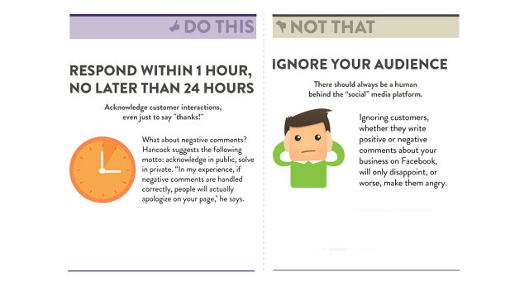
BEST PRACTICES: COMMENTS
Comments
Positively engage with your followers!
Discussion is good, but use your judgment to take a conversation to direct messaging or email.
Notes:
--Engaging with followers, positively, is a great way to build a relationship with them and establish your committee as a reliable source of information and education for your followers.
--Try to respond to the comment in a factual, informative, POLITE way. If you’re not sure how to respond, reach out to your Eboard or the Communications Department for help.
--If you don’t want to respond in the comments, you can, as the page, ask the person to take the conversation to direct messaging. It’s a good way to handle issues offline or just answer questions. We do this regularly with NATCA Facebook and we benefit greatly from interaction with followers because people know we are responsive.
-It’s your decision as page managers to maintain the integrity of your page, so it’s up to you how to utilize the hide comment or block features.

Slide 23
BEST PRACTICES: Tools
Free
Hootsuite
Latergram
Flipagram
Repost
Layout, Pic Collage
Boomerang
Giphy
Pages Manager App
Canva
Keyhole (analytics)
Piktochart (infographics)
Magisto (basic)
Bitly (tracking/metrics)
Not Free
Sprout Social (free trial)
Magisto (upgraded or business version)
Boosting or sponsoring posts
Notes:
-There are more out there, but these are some basic ones to get you started.

Slide 24
BEST PRACTICES: TOOLS
Notes:
-An example of a graphic created through using Canva.

Slide 25
BEST PRACTICES: TOOLS
Notes:
-Another graphic created through Canva. An example of taking an article and instead of sharing plain text, creating a more engaging type of content.

Slide 26
Social Media: Gray Areas
Incidents or accidents
No matter your privacy settings, what you post isn’t private
Avoid engaging in discussion by describing what you witnessed or what you were involved in
Notes:
-When something happens, please don’t post about it. There will most likely be an FAA investigation or NTSB investigation and you don’t want to do anything to interfere with that.
-When in doubt, don’t post. Contact the National Office Communications Department.

Slide 27
Social Media: Gray Areas
Posting from personal accounts
Federal employees do not have the same First Amendment right to unfettered free speech that other citizens have.
Keep this in mind before posting!
Notes:
-The courts have recognized that the speech of a federal employee on a blog or other social media site is not always protected as free speech by the First Amendment because the government, as the employer, has an interest in certain information not being revealed or in the agency not being cast in a light that would undermine public confidence…By accepting employment as a federal employee, you implicitly acknowledge some limitations on your First Amendment right to free speech.

Slide 28
Social Media: Gray Areas
Hatch Act
Federal employees may express their opinions about a partisan group or candidate in a partisan race (e.g., post, “like,” “share,” “tweet,” “retweet”), but there are a few limitations. Specifically, the Hatch Act prohibits employees from:
engaging in any political activity via Facebook or Twitter while on duty or in the workplace;
referring to their official titles or positions while engaged in political activity at any time (note that inclusion of an employee’s official title or position on one’s social media profile, without more, is not an improper use of official authority); and
suggesting or asking anyone to make political contributions at any time. Thus, they should neither provide links to the political contribution page of any partisan group or candidate in a partisan race nor “like,” “share,” or “retweet” a solicitation from one of those entities, including an invitation to a political fundraising event. An employee, however, may accept an invitation to a political fundraising event from such entities via Facebook or Twitter.
Notes:
Office of the Special Counsel – Hatch Act social media and email FAQs

Slide 29
Social Media: Gray Areas
Hatch Act
Q: What should a federal employee do if an individual posts or “tweets” a message soliciting political contributions to a partisan group or candidate in a partisan race, or a link to the political contribution page for such entities, on the employee’s social media page?
A: Although the Hatch Act prohibits federal employees from soliciting or receiving political contributions at any time, employees are not responsible for the statements of third parties, even when they appear on their social media page. Thus, if an individual posts a link to the political contribution page of a partisan group or candidate in a partisan race, or otherwise solicits political contributions, the employee need not take any action. The same advice applies to any “tweets” directed at the employee. However, the employee should not “like,” “share,” or “retweet” the solicitation, or respond in any way that would tend to encourage other readers to contribute.
Notes:
Office of the Special Counsel – Hatch Act social media and email FAQs

Slide 30
Social media: Policies
FAA Policy
NATCA Policy
Contact Sarah McCann if considering or planning to set up an account
Guidance
Master list of other accounts

Slide 31
SHAMELESS PLUG
Facebook
NATCA
Twitter
@NATCA
Instagram
NATCA National
LinkedIn
Company page for National Air Traffic Controllers Association
Flickr
NATCA
YouTube
NATCA National

