Slide 1
“The Art of Listening”
Daniel W Zenga Ed.D,LP

Slide 2
“Goal”
Assist the Professional Standards volunteer to recognize and enhance effective communication skills
In order to communicate effectively with someone it is important to understand that person’s cognitive organization (Rules/Convictions)

Slide 3
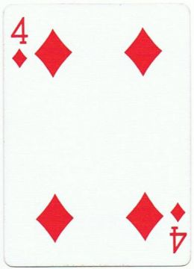

Slide 4
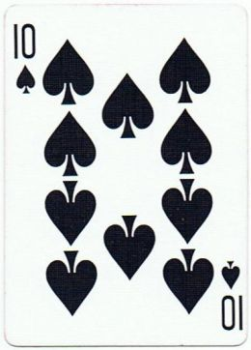

Slide 5
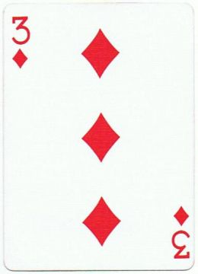

Slide 6
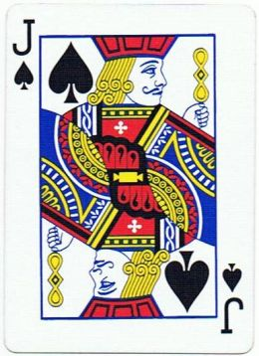

Slide 7
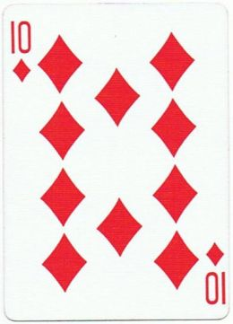

Slide 8
“What Are the Rules?”
Convictions that a person develops to help organize experiences, to understand it, to predict it, and to control it.

Slide 9
“Rules/Convictions”
Self Concept - Rules About Me
Self Ideal Shoulds of the Individual
Environmental Evaluation - Things that are not me
Ethical Conviction - Conviction of Right/Wrong

Slide 10
“Influences”
Heredity
Family Atmosphere
Family Values
Guiding Lines
Culture

Slide 11
“Common Pilot Characteristics”
Physically and Mentally Healthy
Self-Sufficient
Concerned about Modifying Environment rather than Changing our own Behavior
Prefer Short Range Goals- Immediate feedback
Excitement Seekers
(Skiados)

Slide 12
“Common Pilot Characteristics”
Intelligent- Concrete, Practical, Linear
Competitive
Suspicious
Long Memories for Perceived Injustices
Analytical vs. Feeling Oriented
(Skiados)

Slide 13
“Generation X”
Less Respect for Authority
Strong Desire for Rules to be Justified
Expect Rules Should be Flexible and Negotiable
Very High Expectations
Intrinsic Sense of Entitlement
(Wilson 2005)

Slide 14
“Generation X”
Short Time Horizons
Expectation of Rapid Advancement at Work
Little Expectation at Current Job as a Life-long Career
Likes the idea of “Job Hopping”
Very Strong Willingness to Strike

Slide 16
“Conflict”
Deny
Rationalize
Doesn’t See it
Change the Experience
Does Not Change the Rule

Slide 17
“Communication Tips”
Observe Your Behavior
Be Flexible
Make an Effort to Understand Others
Accept Change
Don’t Take it Personally

Slide 18
“Effective Listening”
Stop Talking
Try to put yourself in the others place
Take your cues for response or action from what the person is saying
Don’t guess what the other person is going to say
Avoid judging the person

