Slide 1
Communications
Notes:
SAY:
We’ll be using a power point to cover some of the information, there will also be class discussion as well as some role play to utilize some of the skills we will cover today. This will assist the Professional Standards volunteer to recognize and enhance effective communication skills needed to preform as a committee member.

Slide 2
Session Objectives
Preparing for the conversations.
The difference between hearing and listening.
Defining active listening.
Barriers to being an effective listener.
Influences, values and distractions.
Overcoming the barriers.
Learning to reframe.
Notes:
SAY:
Read slide

Slide 3
Preparing for the Conversation
Find a private location.
Have the case checklist with you.
Prepare for possible negative reactions.
Don’t be judgmental or accusatory.
Enter the meeting with curiosity and empathy.
Notes:
You want to find a private location
SAY – Try to find a location where there is some privacy and will not be interrupted. Keep those involved to only those that need to be.
Have the Case checklist
SAY – We do not keep notes except for the case receipt checklist
Prepare yourself for possible negative reactions.
SAY – At times people will get uncomfortable with discussing professional standards. When this occurs they will get defensive a possibly the conversation will get emotional. Being prepared for that possibility will allow you to remain calm and guide the conversation to a successful outcome.
Be careful not to have made judgments or be suspicious. Enter the meeting with curiosity and with empathy.
SAY – When we prepare for a meeting, we need to put our own judgments aside and think like a mediator. Change our orientation of thinking from suspicion, blame and judgment to curiosity, contribution and compassion. When you put yourself in the other persons shoes, realizing that they have a different perspective, it is easier to get to a solution and the issues.

Slide 4
Time for the Initial Conversation
State the purpose of the conversation and what you hope to accomplish at the end.
Then LISTEN, paraphrase and reframe – hear out the other person, listen attentively.
Never interrupt except when the discussion goes into a different direction.
Notes:
State the purpose of the conversation and what you hope to accomplish at the end.
SAY – Be direct but respectful. We are fact finding, we do not have any of the answers at this point. Once you finish your introductions, let the subject speak uninterrupted.
Then LISTEN, paraphrase and reframe – hear out the other person, listen attentively.
SAY – Paraphrasing/reframing are some of the most difficult listening skills. They can include feelings as well as facts. “I understand how you must feel.” It considers nonverbal cues, and helps prevent misunderstandings.
Never interrupt except when the discussion goes into a different direction.
SAY – It takes a person time to get to open up and discuss the core of the problem. Typically the conversation will include others, history. If we interrupt, we break that train of thought and it might not allow the person to unveil the true cause of the issue. However, if the conversation is moving in a negative direction, we must interrupt and redirect.

Slide 5
Communication
Is there a Difference between Hearing and Listening?
“ProStandards is so simple even a Caveman can do it” G. Koleszar

Slide 6
Notes:
Is there a difference between hearing and listening?
SAY- What is hearing?
SAY - To hear is to perceive with our ears the words that are spoken. It is the physical act of recognizing someone is speaking.
Everyday listening is often more about listening to yourself than to the other person. This is listening but from your own perspective while engaging with the mind talk in your head and simultaneously having a conversation with yourself. This kind of listening is filtered through your own beliefs, values and experiences. This type of listening, where we are already generating our response, is flawed and is not true active listening
To be an active listener is to be engaged in what a speaker is saying. Paying full attention to the words, and at times, the mood of the person speaking without falling victim to what your mind is ‘speaking’. We will talk more about that later.

Slide 7
Some listening is easy, but “active” listening is hard work
Low energy High energy
Coaching Session
Conflict Resolution
Mediation
Party
Radio
Classroom
Meetings
Interview
Facilitation
“Active”
Listening
Notes:
Review diagram
Let’s identify some listening asks that require different energy levels.
Workbook.
Low to high
Party/Radio
Classroom/Meetings
Interview/Facilitation
Coaching/Conflict Resolution/Mediation
SAY - Active listening is not an easy task. It takes time to develop and can be exhausting.

Slide 8
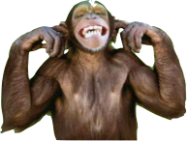
Are you a good listener?
Notes:
Exercise – ask questions
face the speaker and make eye contact?
keep your body attentive and still?
create the right environment?
Encouragement
Check for understanding
Invite the person to begin speaking
Smile, nod or acknowledge?
Do you paraphrase and summarize?

Slide 9
Do You “Close the Door”
on a Conversation?
Offering
Judgments
Criticizing or praising the speaker.
Labeling / diagnosing the person or problem.
Offering unsolicited advice.
Digging for answers with excessive questioning.
Trying to provide ‘our’ solution.
Sending
Solutions
Avoiding
Concerns
Diverting content to a new topic.
Using logic or reassurance to deflate the issue.
Notes:
Read slide

Slide 10
What are some barriers to Active Listening?
Notes:
SAY-To become a better listener, the first step is to understand what barriers stand in our way
Overcoming these barriers can be the biggest step in helping you communicate better with others.
Skilled listeners are active listeners.

Slide 11
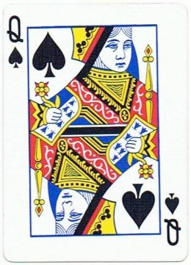
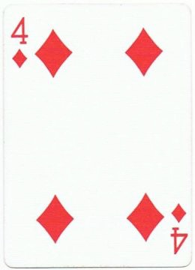
Notes:
Just go along with me here,
Which card am I thinking of?

Slide 12
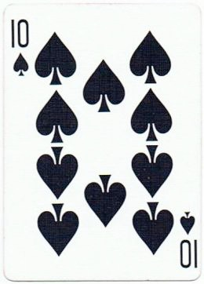
Notes:
Now

Slide 13
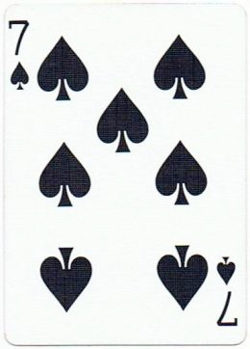
Notes:
Now

Slide 14
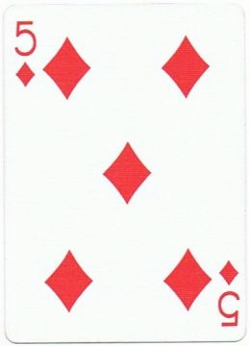
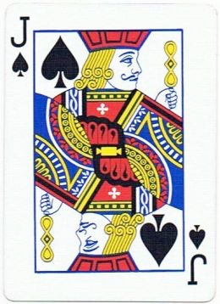
Notes:
Now
ASK - What pattern or cognitive rule am I following?
(high card, spades, left right left right)
We all follow different rules, thinking differently. Our role is to understand where they are coming from, why they are coming from there, and then facilitate a resolution from there.

Slide 15
“What Are the Rules?”
Convictions that a person develops to help organize experiences, to understand it, to predict it, and to control it.
Notes:
Everyone has rules. In life, the test of a rule is does it work? Some people who have highly complex rules are said to have obsessive compulsive disorder

Slide 16
Notes:
Okay, how about now?
Now we need to redefine our rule, or ignore this set of cards and still believe in the pattern we were following

Slide 17
In order to communicate effectively with someone it is important to understand that person’s cognitive organization
(Rules/Convictions)
Notes:
We all see things through different filters/lenses.
ASK – does anyone know what the definition of empathy is?
Empathy is the capacity to recognize and to some extent, share feelings, that are being experienced by another person. It is understanding what they are feeling and thinking. Often when there is conflict, it is because under our “rules”, the actions of others makes no sense.

Slide 18
“Rules/Convictions”
Self Concept - Rules About me.
Self Ideal – “Shoulds” of the Individual.
Environmental Evaluation - Things that are not me.
Ethical Conviction - Conviction of Right/Wrong.
Notes:
Self concept - rules about me. I am tall/short, shy/outgoing, thin/heavy. This is how we define ourselves
Self Ideal - these are the should of the individual. I should be tall, thin, outgoing etc. This is where the conflict lies within the individual. The self concept vs the self ideal
Environmental Evaluation – These are things that are not me. Often a prejudicial belief.
Ethical Conviction – I like my desk organized, the person at the other desk has piles everywhere. Neat is right, piles are wrong We all have different rules.

Slide 19
“Influences”
Heredity
Family Atmosphere
Family Values
Guiding Lines
Culture

Slide 20
Attachment to Personal Beliefs and Values
Having a strong bond to our personal points of view is among the toughest barriers to effective listening.
Our personal beliefs and values are an integral part of our personal points of view and we dismiss anything that weakens them.
Consider the view of others.
Be curious about others’ point of views and the reasons why they hold them.
Notes:
Having a strong bond to our point of view is among the toughest barriers to effective listening
SAY – When people are expressing a different point of view, we may be thinking how wrong they are, or what we will say to convince them of our truth, or we may get defensive about them trying to convince us of their truth
Our beliefs makes us who we are and it is natural to create data that supports that concept.
Be curious about others’ point of views and the reasons why they hold them
SAY – this is important, substitute your suspicion for curiosity. What were they thinking? When you replace suspicion or attachment, your listening will improve dramatically.
SAY - It is very difficult to overcome our personal beliefs and values. Putting them aside during the interviews is an integral part to the success of the professional standards program

Slide 21
Distractions
We get distracted by what is going on both outside and inside.
What are some examples of distractions?
Notes:
SAY – (read slide) not as easy as we think though
ASK - What are examples of outside distractions?
Noises, temperatures, what people are saying or doing?
ASK - What are inside distractions?
Thoughts. Thoughts as memories, judgments, opinions, expectations, worries, fears, misinterpretation
Exercise - Flow Chart distractions.
List internal and external distractions
Discuss how to avoid the distractions

Slide 22
Overcoming the Barriers
When you find yourself getting distracted internally or externally, pay attention by refocusing.
When you discover any attachment to your point of view, let go of it. Become curious about others’ points of view.
When a speaker says something that is unclear, avoid misinterpretations by asking the speaker what their intent was.
Notes:
Read slide

Slide 23
When Appropriate, Give Feedback
Be direct and never judgmental.
Good news or bad, say it clear, simple, direct and in a tactful manner.
Involve the person in the solution.
Refrain from the words “but”, “never”, “should”, “must” or “always”.
Respect them enough to thank them for taking the time to explain their situation.
Notes:
Be direct and never judgmental
- Good news or bad, say it clear, simple, direct and in a tactful manner.
SAY – Continue the conversation with empathy and respect, but be direct
Involve the person in the solution
SAY – involving the person in the solution often gets their buy in to the resolution. Ask for their help in overcoming the issue at hand. What are their thoughts?
Refrain from the words, “but”, “never” “should”, “must” or “always”.
SAY - “you” is accusatory and tends to place blame
“but” is argumentative and negates what was said.
“always” and “never” are absolutes and can be considered degrading and humiliating. It indicates you have already allowed your convictions to take over.
Respect them enough to thank them for taking the time to explain their situation.
Thank them for their time to make this program successful. We cannot be successful with out them.
Apologize

Slide 24
Best Practices
Make a habit of not interrupting the person when they are speaking.
Ask probing questions, this also means you are actively listening.
Try to acknowledge that you are listening.
Summarize/reframe what you have heard.
Maintain eye contact.
Notes:
Make a habit of not interrupting the person when they are speaking.
SAY As simple as this may seem, it is extremely important that you abide by this rule. Let the speaker finish their statement before trying to reply or ask a question.
Ask probing questions, this also means you are actively listening
SAY – When you ask questions, try not to ask more than 1 question at a time and do not overdue it. Do not try to fill the silence with a question. Sometimes the speaker may just be composing their thoughts on something that might make them uncomfortable but are now willing to share. Utilizing words like “how”, “what”, “describe” or “please explain” ensure the questions are open ended.
Try to acknowledge that you are listening
SAY One of the differences between hearing and listening is that when you are listening, you try to give acknowledgements, from time to time. Words like “I see”, “Aha…”, “I know”, “ I understand” or “I know the feeling”
Summarize or paraphrase what you have heard
SAY – Summarizing has its benefits like preventing misunderstandings and keeping the livliness of the conversation. It also keeps you implicated in the conversation by preventing your attention from wandering far away. You can use words like “Did I understand this right”, “Did you just say that..”

Slide 25
How do we Reframe?
Eliminate blame, negative or derogatory comments.
Use neutral language.
Acknowledge and affirm feelings.
Change negatives into positives.
Avoid judgment.
Emphasize common ground.
Emphasize positives.
Highlight any conciliation.
Add in strong feelings.
Avoid taking sides.
Notes:
The technique of reframing damaging, negative or poisonous language is one of the most important communication skills. It is about transforming strongly felt, but very judgmental- comments that disparage or put people down into something more positive and constructive.
To maintain professional standards we need to manage our communications positively by reflecting back or acknowledging what the person is saying while reframing the negative or derogatory aspects of what is being said.
To be able to reframe negative language competently and quickly takes practice and good communication. When two people are involved in a dispute, your constructive summary of what each person says should both reflect the meaning for the speaker and, at the same time, be acceptable to the other person. A difficult task.
If you reframe it too much the speaker feels you aren’t listening, if not enough the person being criticized feels you are taking sides.
Go ahead and turn to page (?) and you will see a list of phrases that need reframing. Work as a group and reframe each sentence and write the reframed sentence on your flip chart sheet.

Slide 26
Reframing Exercise
“Bob is an idiot. I don’t know how many times I have told him he is screwing things up.”
“He is useless. He should have never been certified.”
“I am getting tired of getting a crappy feed from her. Every time she works I go down the crapper fixing her mistakes.”
“It is like he thinks he is the only one working here.”
Notes:
The technique of reframing damaging, negative or poisonous language is one of the most important communication skills. It is about transforming strongly felt, but very judgmental- comments that disparage or put people down into something more positive and constructive.
To maintain professional standards we need to manage our communications positively by reflecting back or acknowledging what the person is saying while reframing the negative or derogatory aspects of what is being said.
To be able to reframe negative language competently and quickly takes practice and good communication. When two people are involved in a dispute, your constructive summary of what each person says should both reflect the meaning for the speaker and, at the same time, be acceptable to the other person. A difficult task.
If you reframe it too much the speaker feels you aren’t listening, if not enough the person being criticized feels you are taking sides.
Go ahead and turn to page (?) and you will see a list of phrases that need reframing. Work as a group and reframe each sentence and write the reframed sentence on your flip chart sheet.

Slide 27
Reframing Exercise cont...
“All day long I have to listen to his gross sounds. It is disgusting.”
“I am always doing all the work and they don’t do anything.”
“I can’t believe he can sit here and say that. He is the one always making rude comments.”
“That makes sense but I am tired of her always getting her way.”
Notes:
The technique of reframing damaging, negative or poisonous language is one of the most important communication skills. It is about transforming strongly felt, but very judgmental- comments that disparage or put people down into something more positive and constructive.
To maintain professional standards we need to manage our communications positively by reflecting back or acknowledging what the person is saying while reframing the negative or derogatory aspects of what is being said.
To be able to reframe negative language competently and quickly takes practice and good communication. When two people are involved in a dispute, your constructive summary of what each person says should both reflect the meaning for the speaker and, at the same time, be acceptable to the other person. A difficult task.
If you reframe it too much the speaker feels you aren’t listening, if not enough the person being criticized feels you are taking sides.
Go ahead and turn to page (?) and you will see a list of phrases that need reframing. Work as a group and reframe each sentence and write the reframed sentence on your flip chart sheet.

Slide 28
Reframing Exercise cont...
“Really? Did she just say that out loud? She is being ridiculous.”
“His eau de Cologne stinks.”
Garth LePew
Notes:
The technique of reframing damaging, negative or poisonous language is one of the most important communication skills. It is about transforming strongly felt, but very judgmental- comments that disparage or put people down into something more positive and constructive.
To maintain professional standards we need to manage our communications positively by reflecting back or acknowledging what the person is saying while reframing the negative or derogatory aspects of what is being said.
To be able to reframe negative language competently and quickly takes practice and good communication. When two people are involved in a dispute, your constructive summary of what each person says should both reflect the meaning for the speaker and, at the same time, be acceptable to the other person. A difficult task.
If you reframe it too much the speaker feels you aren’t listening, if not enough the person being criticized feels you are taking sides.
Go ahead and turn to page (?) and you will see a list of phrases that need reframing. Work as a group and reframe each sentence and write the reframed sentence on your flip chart sheet.

Slide 29
The most basic and powerful way to connect to another person is to listen. Just listen. Perhaps the most important thing we ever give each other is our attention…..
Rachel Naomi Remen

Slide 30
Questions
Notes:
Questions
Allow participants the opportunity to ask questions.

