Slide 1
Professional Standards and the Importance of Managing Distractions

Slide 2
NATCA Constitution
Section 2.
The objectives of the Association shall be:
To preserve, promote and improve the working conditions of air traffic controllers and other aviation- safety-related employees;
To preserve, promote and improve the safety of air traffic within the United States, its territories and possessions;
To preserve, promote and improve the professionalism and competence of air traffic controllers and other aviation-safety-related employees;
To preserve, promote and maintain the best interests of the United States of America and particularly her leadership role in the aviation community; and
To preserve, promote and improve the rights of its members through all lawful means, including collective bargaining, political action, and contributing to such civic and charitable organizations as the National Executive Board deems in the best interests of the Association.

Slide 3
Professional Air Traffic Controller Code
The goal of the Professional Standards Program, which is contained as a core component of the NATCA/FAA collective bargaining agreement, is to promote and maintain the highest degree of professional conduct among participants. We do that in compliance with the following Air Traffic Controller code:
A Professional Air Traffic Controller’s performance and actions are a demonstration of their personal commitment to safety, excellence, and upholding their oath to the public trust, most specifically to the users of the National Airspace System. They shall conduct themselves in a manner that instills trust and merits the confidence bestowed on them by the public they serve.
A Professional Air Traffic Controller, through his or her own conduct and performance, should inspire, motivate, and provide examples of professionalism to others. The safety of the Airspace system is of the greatest importance and their performance should always demonstrate the highest standard of excellence.
A Professional Air Traffic Controller accepts that their actions represent the conduct and character of all members of the profession. They shall act in a manner that brings honor and respect to the profession, establishes public trust, and sets a global standard for excellence.

Slide 4
Professional Air Traffic Controller Code
The goal of the Professional Standards Program, which is contained as a core component of the NATCA/FAA collective bargaining agreement, is to promote and maintain the highest degree of professional conduct among participants. We do that in compliance with the following Air Traffic Controller code:
A Professional Air Traffic Controller’s performance and actions are a demonstration of their personal commitment to safety, excellence, and upholding their oath to the public trust, most specifically to the users of the National Airspace System. They shall conduct themselves in a manner that instills trust and merits the confidence bestowed on them by the public they serve.
A Professional Air Traffic Controller, through his or her own conduct and performance, should inspire, motivate, and provide examples of professionalism to others. The safety of the Airspace system is of the greatest importance and their performance should always demonstrate the highest standard of excellence.
A Professional Air Traffic Controller accepts that their actions represent the conduct and character of all members of the profession. They shall act in a manner that brings honor and respect to the profession, establishes public trust, and sets a global standard for excellence.

Slide 5
Professional Air Traffic Controller Code
The goal of the Professional Standards Program, which is contained as a core component of the NATCA/FAA collective bargaining agreement, is to promote and maintain the highest degree of professional conduct among participants. We do that in compliance with the following Air Traffic Controller code:
A Professional Air Traffic Controller’s performance and actions are a demonstration of their personal commitment to safety, excellence, and upholding their oath to the public trust, most specifically to the users of the National Airspace System. They shall conduct themselves in a manner that instills trust and merits the confidence bestowed on them by the public they serve.
A Professional Air Traffic Controller, through his or her own conduct and performance, should inspire, motivate, and provide examples of professionalism to others. The safety of the Airspace system is of the greatest importance and their performance should always demonstrate the highest standard of excellence.
A Professional Air Traffic Controller accepts that their actions represent the conduct and character of all members of the profession. They shall act in a manner that brings honor and respect to the profession, establishes public trust, and sets a global standard for excellence.

Slide 6
Professional Air Traffic Controller Code
The goal of the Professional Standards Program, which is contained as a core component of the NATCA/FAA collective bargaining agreement, is to promote and maintain the highest degree of professional conduct among participants. We do that in compliance with the following Air Traffic Controller code:
A Professional Air Traffic Controller’s performance and actions are a demonstration of their personal commitment to safety, excellence, and upholding their oath to the public trust, most specifically to the users of the National Airspace System. They shall conduct themselves in a manner that instills trust and merits the confidence bestowed on them by the public they serve.
A Professional Air Traffic Controller, through his or her own conduct and performance, should inspire, motivate, and provide examples of professionalism to others. The safety of the Airspace system is of the greatest importance and their performance should always demonstrate the highest standard of excellence.
A Professional Air Traffic Controller accepts that their actions represent the conduct and character of all members of the profession. They shall act in a manner that brings honor and respect to the profession, establishes public trust, and sets a global standard for excellence.

Slide 7
What is the Professional Standards Program?
Program designed to promote and maintain the highest degree of professional conduct among participants by addressing issues in a stand alone peer-to-peer manner.
Program that compliments and supports the ATSAP program.
Non-Punitive.
Allows us to take care of us.

Slide 8
The purpose of the Professional Standards Program is to provide an opportunity for bargaining unit employees to address performance and/or conduct of their peers before such issues rise to a level requiring corrective action(s) on the part of the Agency.

Slide 9
An example of issues that the Professional Standards Program may consider include, but are not limited to:
Individual conflicts
Ineffective operating methods/techniques
Problems of a professional or ethical nature
Conduct that could lead to discipline
Inappropriate Behavior
Recognizing exceptional performance

Slide 10
What is NOT considered
Disagreements over the CBA
Substance abuse covered under Article 73 of the CBA
ATSAP covered events
Legal issues
Criminal activities
Medical related issues
Security violations
Gross negligence

Slide 11
Management Submissions
They may elect to use it as an alternative
A PSC inquiry shall not be used as a triggering event for an inquiry
If the case is resolved, it cannot be used in current or future actions
Confidential
They shall not pursue action while the issue is in committee

Slide 12
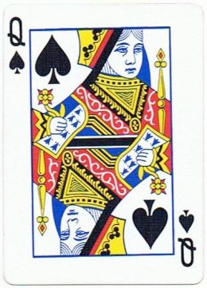
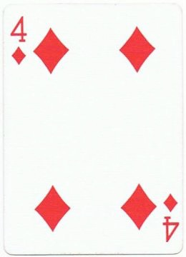
Notes:
Just go along with me here,
Which card am I thinking of?

Slide 13
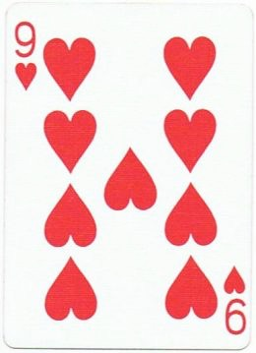
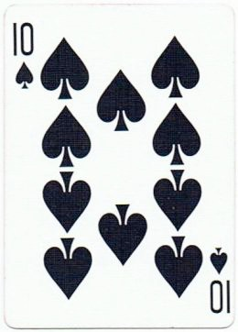
Notes:
Now

Slide 14
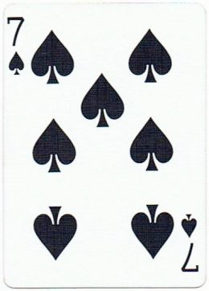
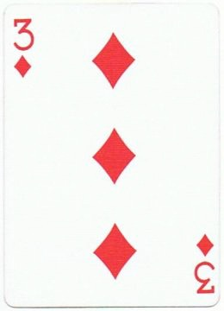
Notes:
Now

Slide 15
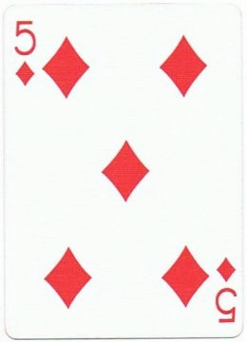
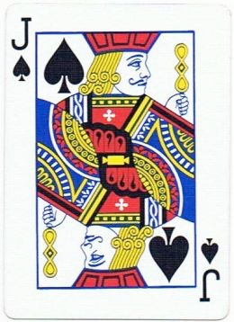
Notes:
Now
ASK - What pattern or cognitive rule am I following?
(high card, spades, left right left right)
We all follow different rules, thinking differently. Our role is to understand where they are coming from, why they are coming from there, and then facilitate a resolution from there.

Slide 16
“What Are the Rules?”
Convictions that a person develops to help organize experiences, to understand it, to predict it, and to control it.
Notes:
Everyone has rules. In life, the test of a rule is does it work? Some people who have highly complex rules are said to have obsessive compulsive disorder

Slide 17
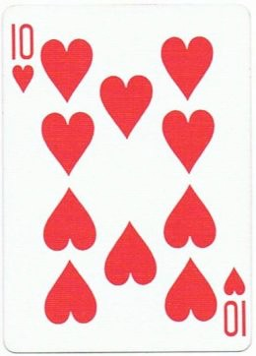
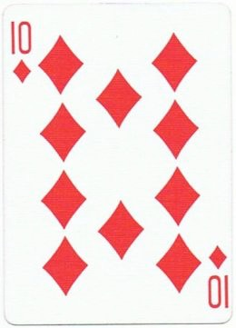
Notes:
Okay, how about now?
Now we need to redefine our rule, or ignore this set of cards and still believe in the pattern we were following

Slide 18
In order to communicate effectively with someone it is important to understand that person’s cognitive organization
(Rules/Convictions)
Notes:
We all see things through different filters/lenses.
ASK – does anyone know what the definition of empathy is?
Empathy is the capacity to recognize and to some extent, share feelings, that are being experienced by another person. It is understanding what they are feeling and thinking. Often when there is conflict, it is because under our “rules”, the actions of others makes no sense.

Slide 19
“Rules/Convictions”
Self Concept - Rules About me.
Self Ideal – “Should’s” of the Individual.
Environmental Evaluation - Things that are not me.
Ethical Conviction - Conviction of Right/Wrong.
Notes:
Self concept - rules about me. I am tall/short, shy/outgoing, thin/heavy. This is how we define ourselves
Self Ideal - these are the should of the individual. I should be tall, thin, outgoing etc. This is where the conflict lies within the individual. The self concept vs the self ideal
Environmental Evaluation – These are things that are not me. Often a prejudicial belief.
Ethical Conviction – I like my desk organized, the person at the other desk has piles everywhere. Neat is right, piles are wrong We all have different rules.

Slide 20
“Influences”
Heredity
Family Atmosphere
Family Values
Guiding Lines
Culture

Slide 21
Attachment to Personal Beliefs and Values
Having a strong bond to our personal points of view is among the toughest barriers to effective listening.
Our personal beliefs and values are an integral part of our personal points of view and we dismiss anything that weakens them.
Consider the view of others.
Be curious about others’ point of views and the reasons why they hold them.
Notes:
Having a strong bond to our point of view is among the toughest barriers to effective listening
SAY – When people are expressing a different point of view, we may be thinking how wrong they are, or what we will say to convince them of our truth, or we may get defensive about them trying to convince us of their truth
Our beliefs makes us who we are and it is natural to create data that supports that concept.
Be curious about others’ point of views and the reasons why they hold them
SAY – this is important, substitute your suspicion for curiosity. What were they thinking? When you replace suspicion or attachment, your listening will improve dramatically.
SAY - It is very difficult to overcome our personal beliefs and values. Putting them aside during the interviews is an integral part to the success of the professional standards program

Slide 22
Importance of Managing Distractions

Slide 23
Distractions Workgroup
The Distractions Workgroup seeks to uphold the safety of the NAS through continued awareness and education regarding the safety impact of distractions, with an emphasis on electronic distractions.

Slide 25
Duty
Position Overload/Experience/Location
Communication
Equipment
External Business
OJTI
Reduced Traffic

Slide 26
Non-Duty
Communication
Other Tasks
Media
Electronic

Slide 27
^{October 21, 2009}
“...allowed this conversation to monopolize their attention and thus lower their capacity to monitor their radio communications, notice the lack of contact [with ATC] and recognize, via airplane instruments, the flight’s progress.”
“The computers not only restricted the pilots’ direct visual scan of all cockpit instruments but also further focused their attention on non- operational issues, contributing to a reduction in their monitoring activities, loss of situational awareness and lack of awareness of the passage of time.”

Slide 28
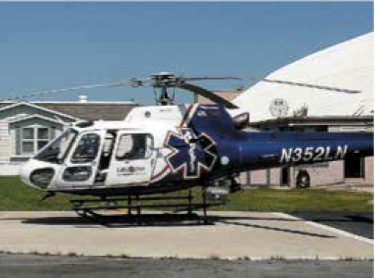
^{August 26, 2011}
Among the contributing factors was “the pilot’s distracted attention due to personal texting during safety-critical ground and flight operations,”

