Slide 1
Pay Calculator Briefing

Slide 2
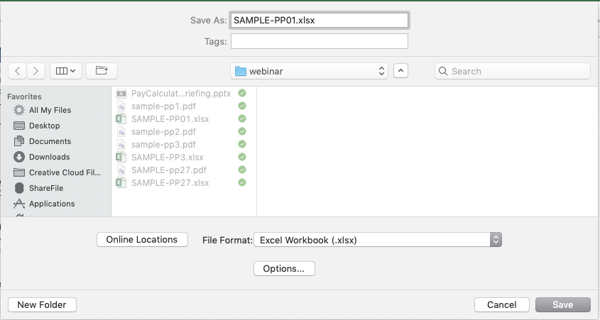
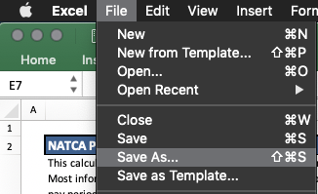
Purpose
Recreate a Leave and Earning Statement (LES) for a specified pay period
Not limited to government shutdown
One pay period per document

Slide 3
Required Information
Download LES from Employee Express for pay periods 2018/27 – 2019/3
Updated version of pay calculator
Will be sent out regularly with updates and bug fixes

Slide 4
Step 1 – Employee Information
Employee Information
Federal Tax Information
Controller Incentive Pay
Leave Starting Balances

Slide 5
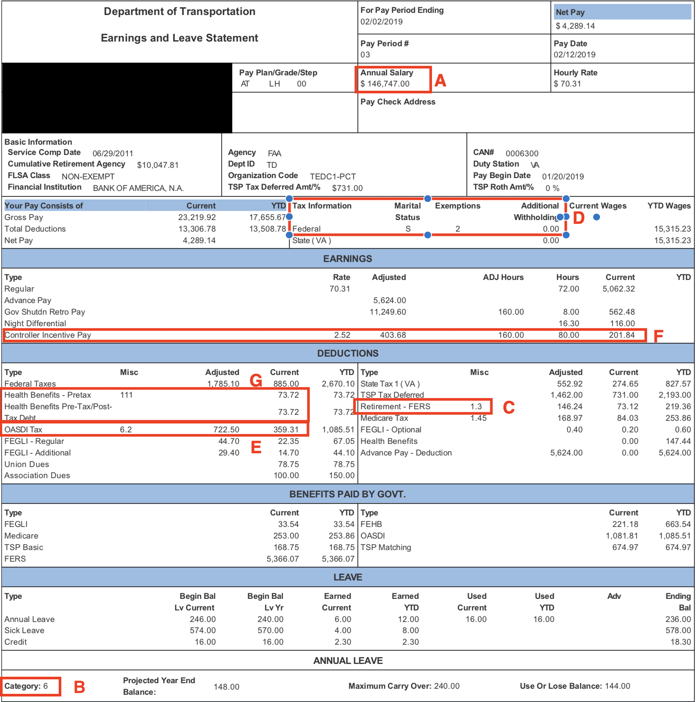
Sample LES
Pay Period 3 of 2019
Annual Salary
Annual Leave Earned Per Pay Period
FERS %
Varies by member, based on hire date
Federal Tax Withholding Information
OASDI Amount
If calculating a pay period and cap has been reached enter $0 or amount remaining to reach cap. 2018 - $7,960.80
2019 - $8,239.80
CIP Amount/Hours Worked
Enter Current in CIP Amount and Hours in Hours Worked
Health Benefits/Health Insurance

Slide 6
Step 1 – Employee Information (cont.)
Deductions
Some deductions are exempt from tax
Most common deductions have been pre-populated
Can enter either a percentage or dollar amount
Percentage takes precedence

Slide 7
Deductions
Pay Period 3 of 2019

Slide 8
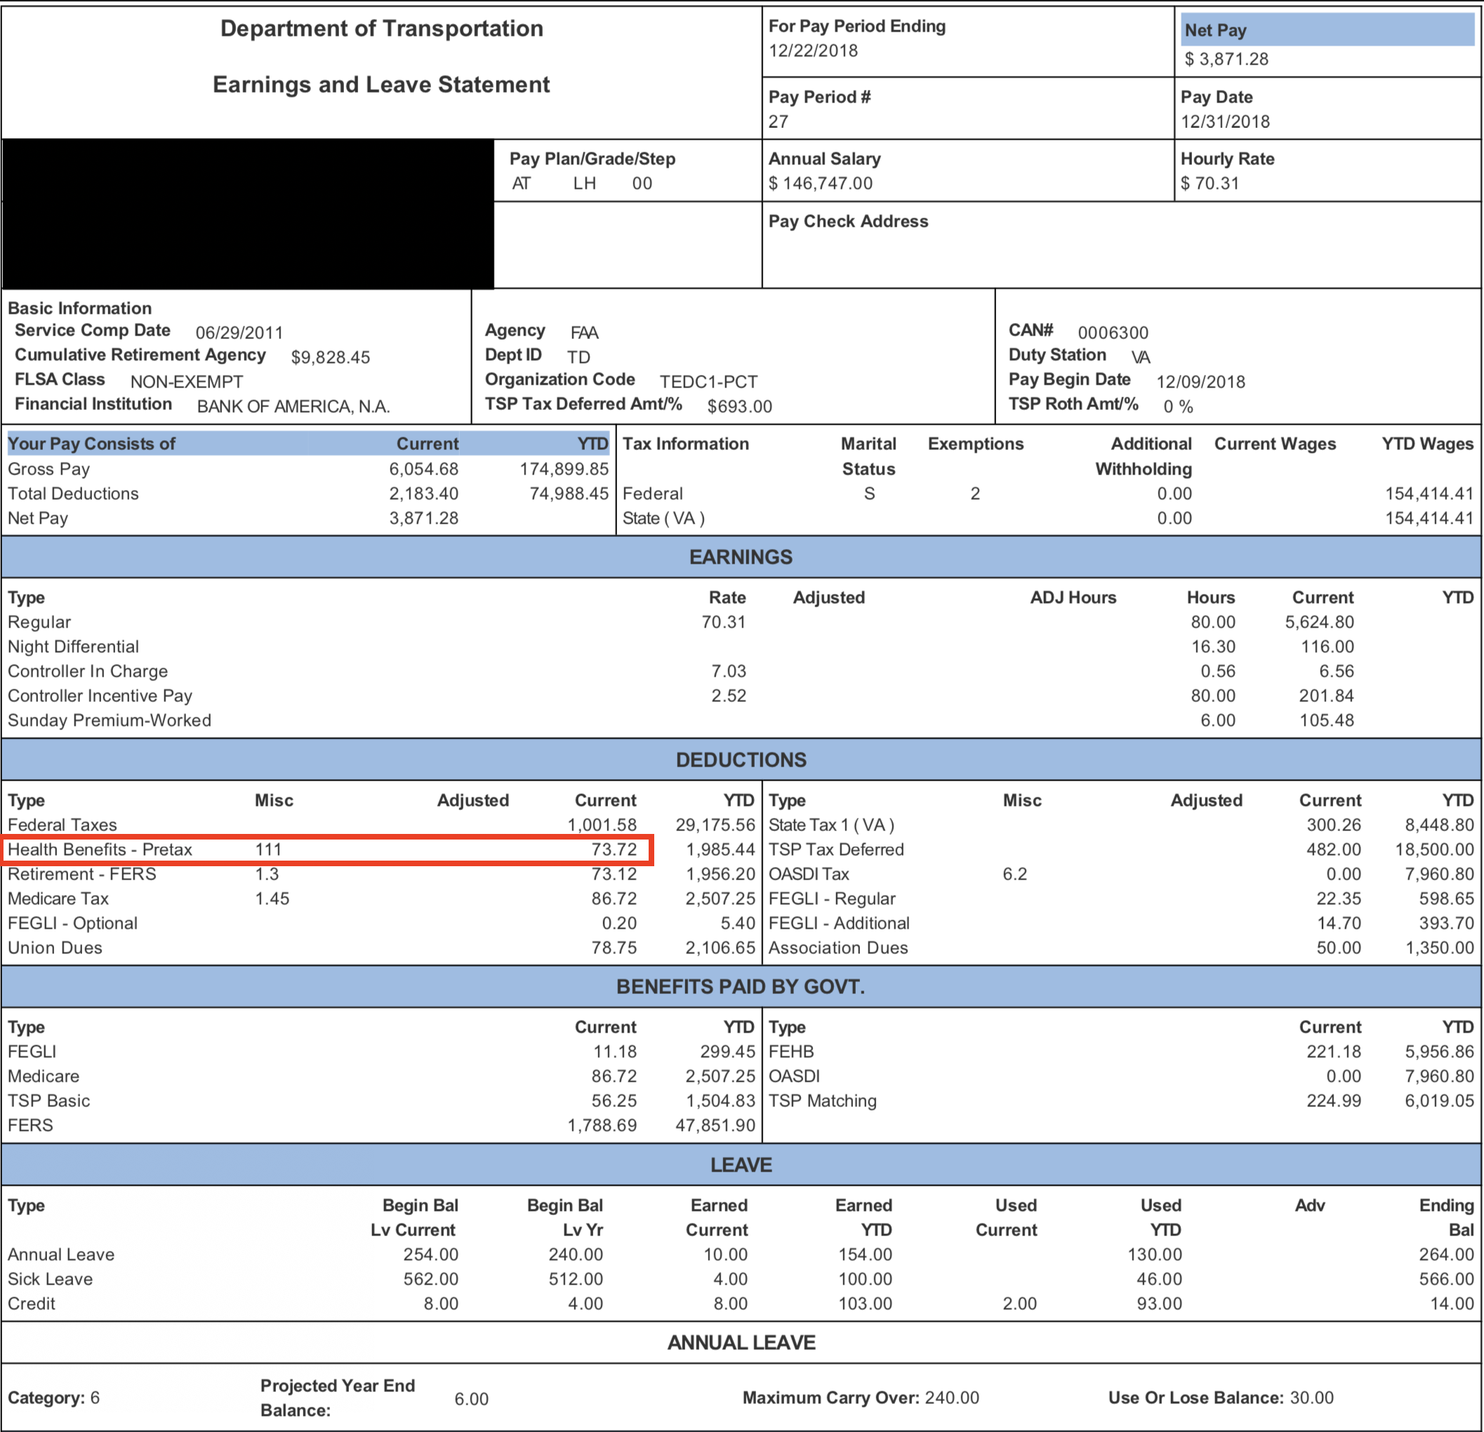
Sample LES
Pay Period 27 of 2018
Values for Health/Dental/Vision for 2018
New amounts take effect in pay period 2

Slide 9
Step 2 - Hours Worked
Enter Year and Pay Period for this calculator
Automatically inserts start and end dates
Determines tax rates used by calculator
Shifts Worked
CRU-ART is the source
Select Activity for the day
RDO, Worked, Leave, Overtime, Holiday, Earn Credit
Enter one shift per line
Midnight shifts are entered on the day the shift ENDS
Differentials are calculated based on this assumption
Night differential will be paid for shifts in furlough status

Slide 10
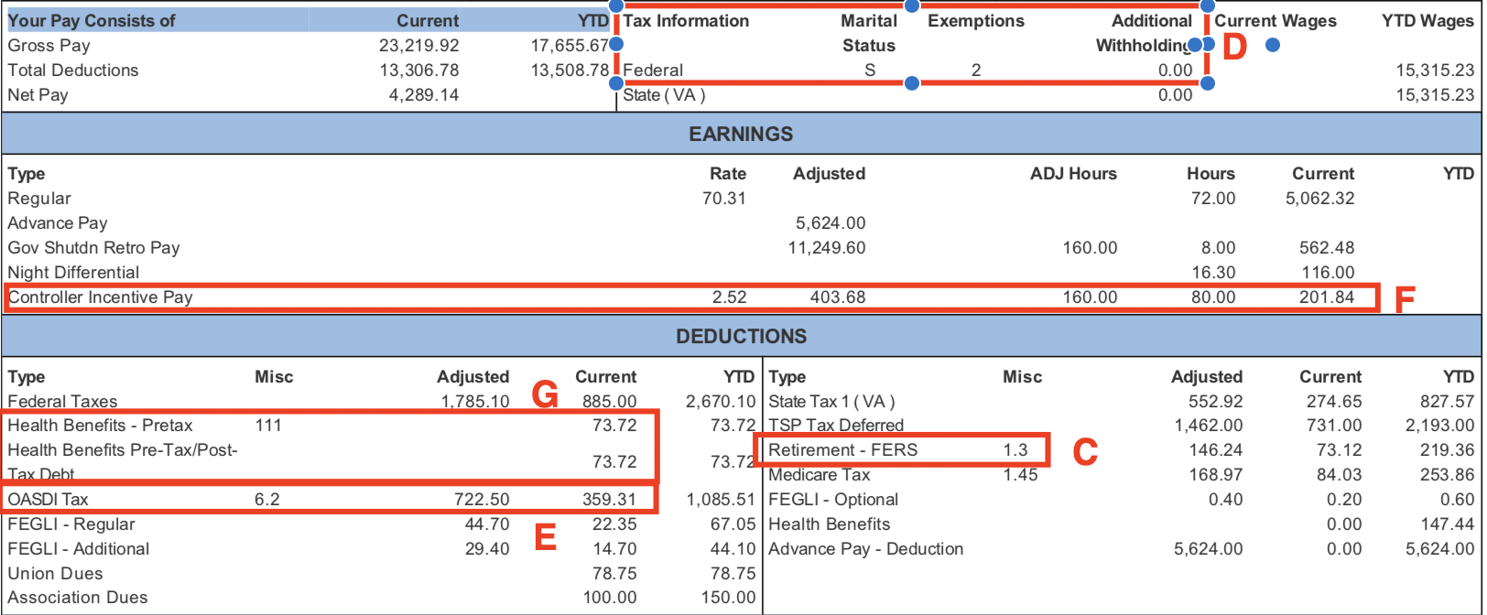
Step 2 – Hours Worked

Slide 11
Step 2 - Hours Worked (cont.)
Leave Used
Enter Leave Type and Start/End times
Adjusts night differential/Sunday pay based on time actually worked
Time Outside Shift
Overtime (Holdover), Credit Hours, Travel Comp
Calculates new leave balance and adds overtime hours
Hours Worked Summary
Calculates hours worked for each pay type
Override column allows for manual entry of time worked
Delete all values to utilize calculated values
CIC/OJTI
Can be entered as Minutes or Hours:Minutes

Slide 12
Step 3 - State Taxes
Too many scenarios to incorporate into spreadsheet
Use information calculated in the spreadsheet to estimate state tax withholding
https://www.paycheckcity.com/calculator/salary/
Data in Green Boxes should be entered into the calculator along with your elections
Enter the results into the “State Taxes” box towards the bottom of the page

Slide 13
LES Summary
Provides a printable summary of earnings and deductions with a NET PAY box to show total amount due for the pay period
Displays updated leave balances
Can be used to compare payment received in PP3/4 to what is expected from PP1/2
Values displayed are generally within $.02 of actual amounts
EXCEPTION: State taxes vary within $5-10

Slide 14
Questions?
For questions, to report bugs, or request most updated version:
paycalculator@natca.net

